Slide 1
2019 Machine Learning II Kannada Digits Recognition
Junchi Tian
Jingshu Song
Yiming Dong

Slide 2
Outline
Motivation
Description of dataset
Network and training algorithm
Modeling
Results
Reference

Slide 3
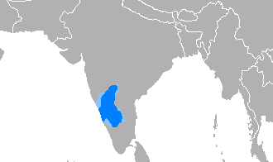
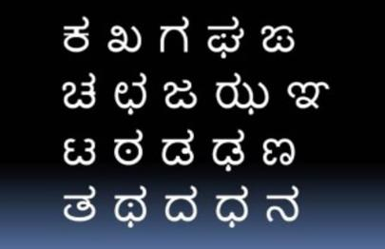
Motivation
Kannada is a language spoken predominantly by people of Karnataka in southwestern India.
The language has roughly 45 million native speakers and is written using the Kannada script.

Slide 4
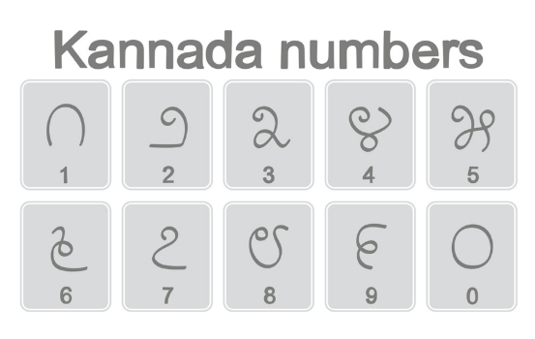
This dataset is similar as the most famous computer vision dataset: handwritten digits recognition provided by Yann LeCun. Instead of using Arabic digits, this dataset uses Kannada digits.
This is a multi-classification model and will be used to recognize Kannada numeric from 0 to 9.
Description of Dataset

Slide 5
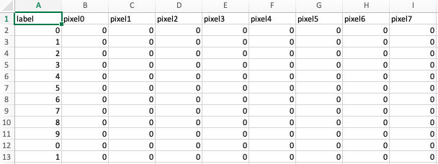
Description of Dataset
Kannada-MNIST dataset: 28X 28 grayscale images: 60k Train | 10k Test
Raw Data can be accessed from Kaggle.com : https://www.kaggle.com/c/Kannada-MNIST

Slide 6
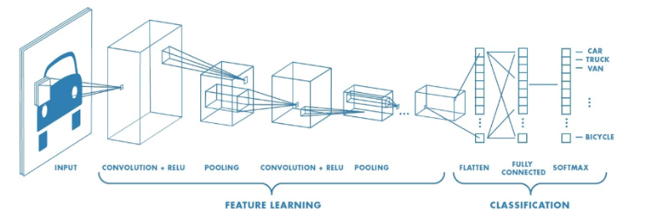
The Framework and deep network
Keras + CNN

Slide 7
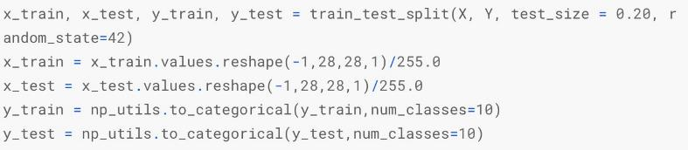
Data Preprocessing

Slide 8
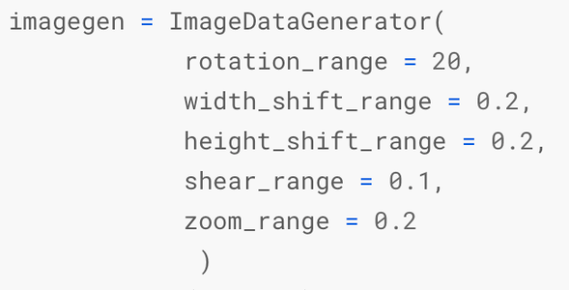
Image Generator

Slide 9
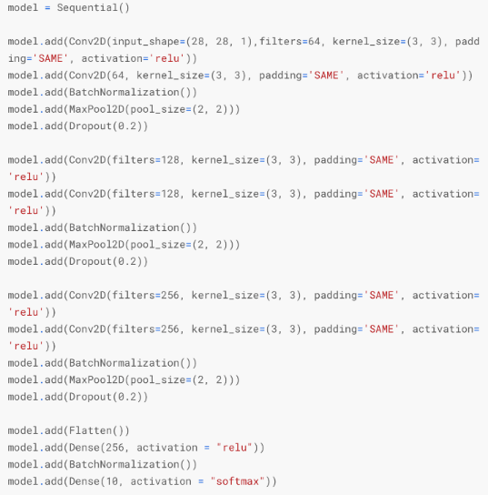
Modeling

Slide 10
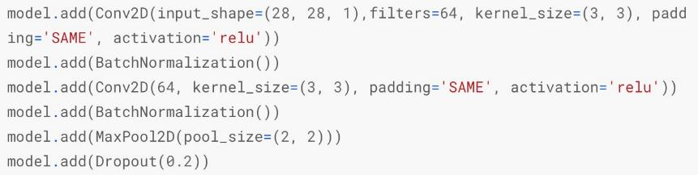
Remove BatchNomalization
Fix CNN Overfitting

Slide 11
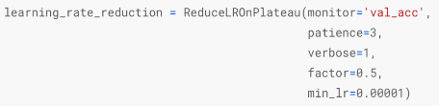
Learning Rate Reduction

Slide 12
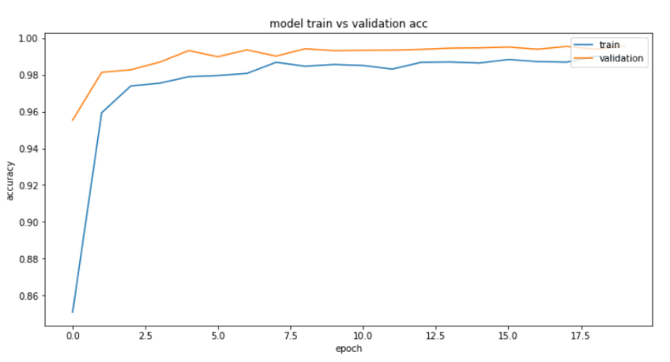
The first submission

Slide 13
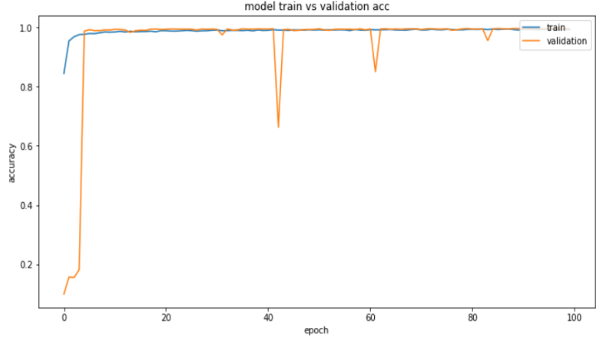
Overfitting

Slide 14
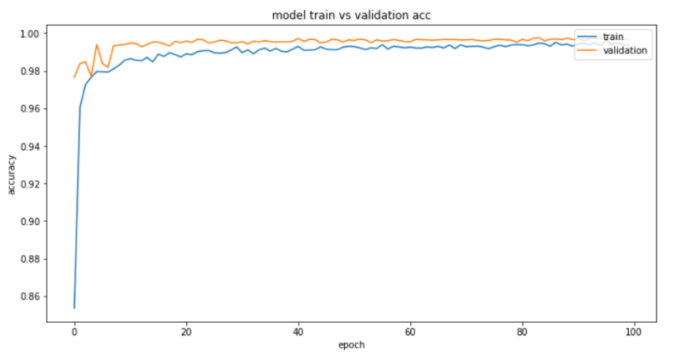
Final Accuracy

Slide 15
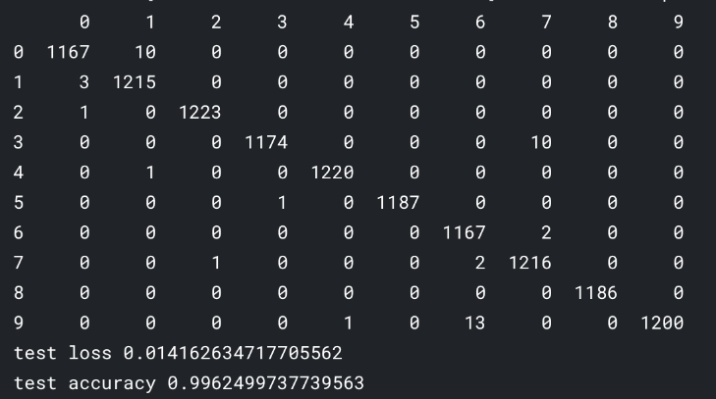
Final Results

Slide 16
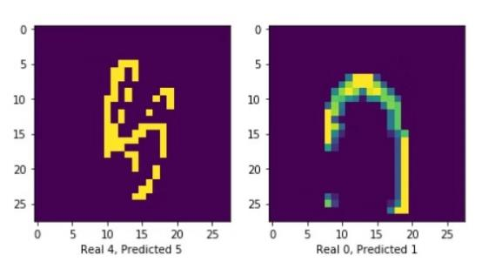
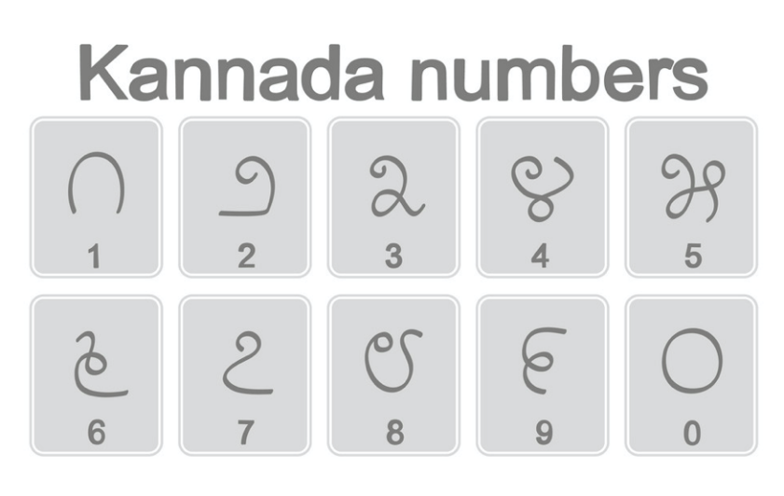
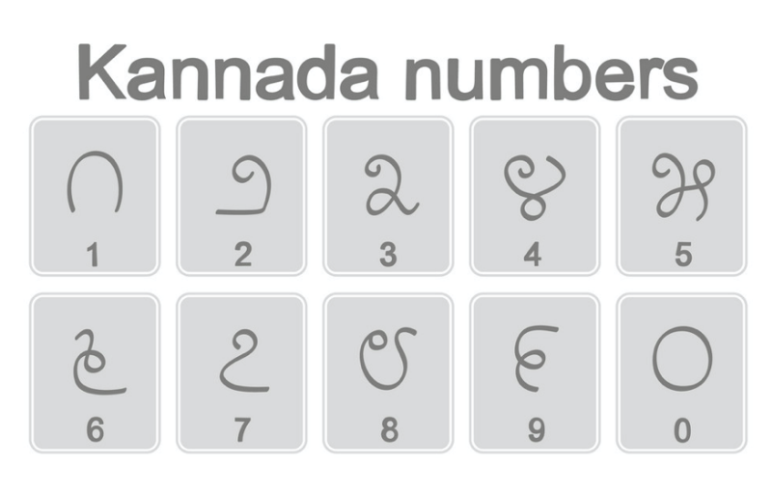
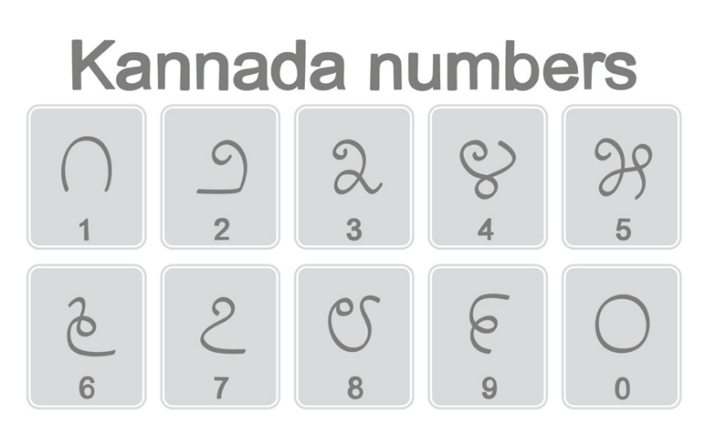
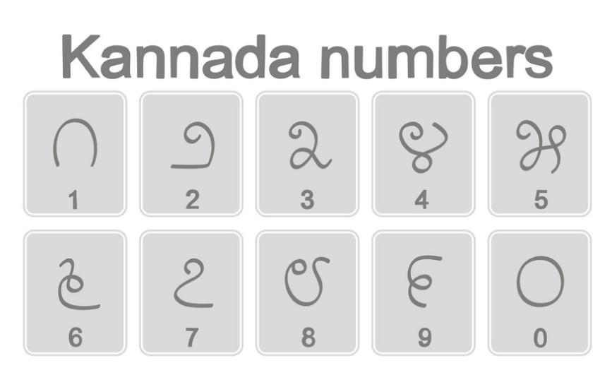
Visualization

Slide 17
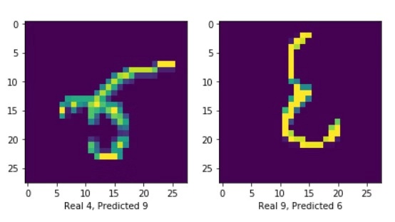
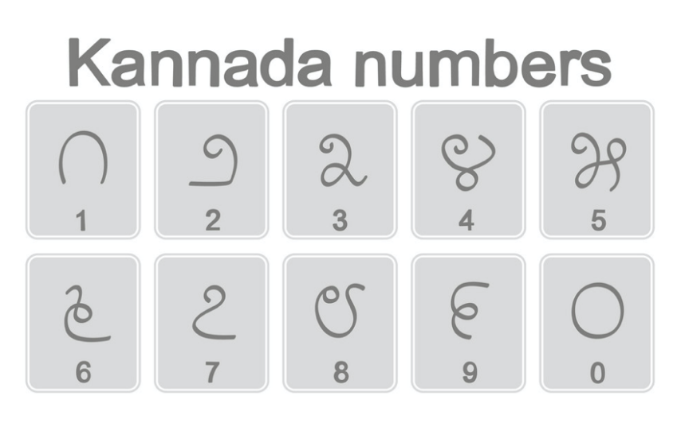

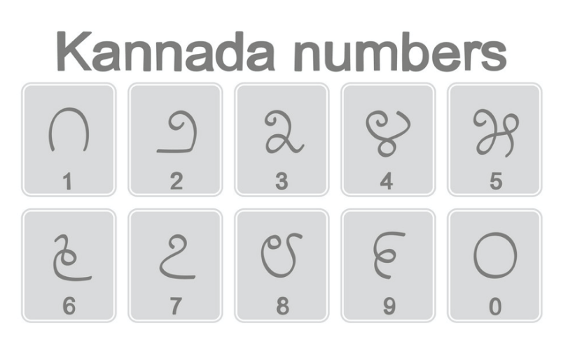
Visualization

Slide 18
Reference
Y. LeCun, L. Bottou, Y. Bengio, and P. Haffner. "Gradient-based learning applied to document recognition." Proceedings of the IEEE, 86(11):2278-2324, November 1998.
Prabhu, Vinay Uday. "Kannada-MNIST: A new handwritten digits dataset for the Kannada language." arXiv preprint
Vinay Uday’s github: https://github.com/vinayprabhu/Kannada_MNIST

Slide 19
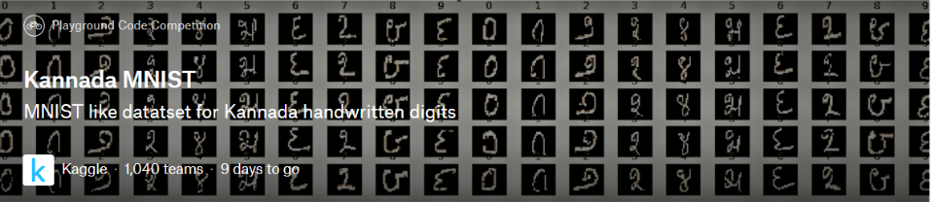
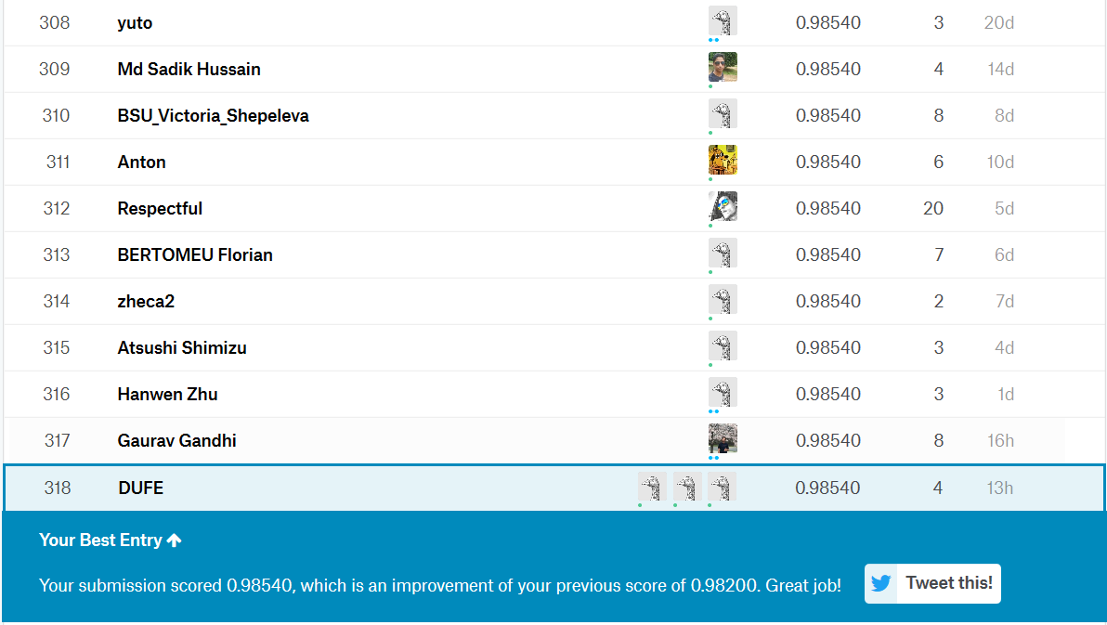
Kaggle Ranking

Slide 20
Thank You

